Slide 1
Impact of Future Rain/snow transition height On Glacier mass balance (iFROG)
BRUN Fanny
MENEGOZ Martin
SIX Delphine
BOUDEVILLAIN Brice
GOUTTEVIN Isabelle
DUMONT Marie
REVEILLET Marion
+ Arnaud REBOUD (stage M2, 5 months)
+ PhD (starting Oct. 2022)
+ Postdoc (2 years, starting in 2022)

Slide 2
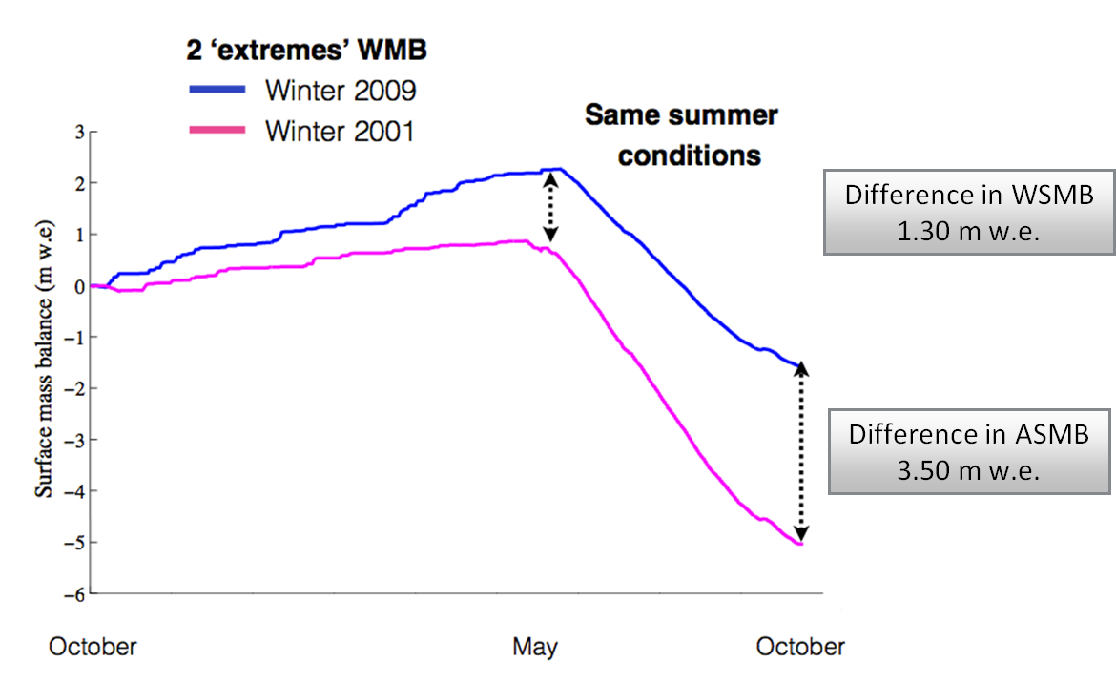
What we already know:
What we would like to know:
What will be the impacts of the albedo feedbacks on the future?
Are they the same everywhere?
How much do we miss with state-of-the-art glacier evolution models?
Point surface mass balance simulated with Crocus mode, using averaged summer conditions (over 1996–2015), snowy winter conditions (pink) and dry winter conditions (blue). Adapted from Réveillet et al., 2018.

Slide 3
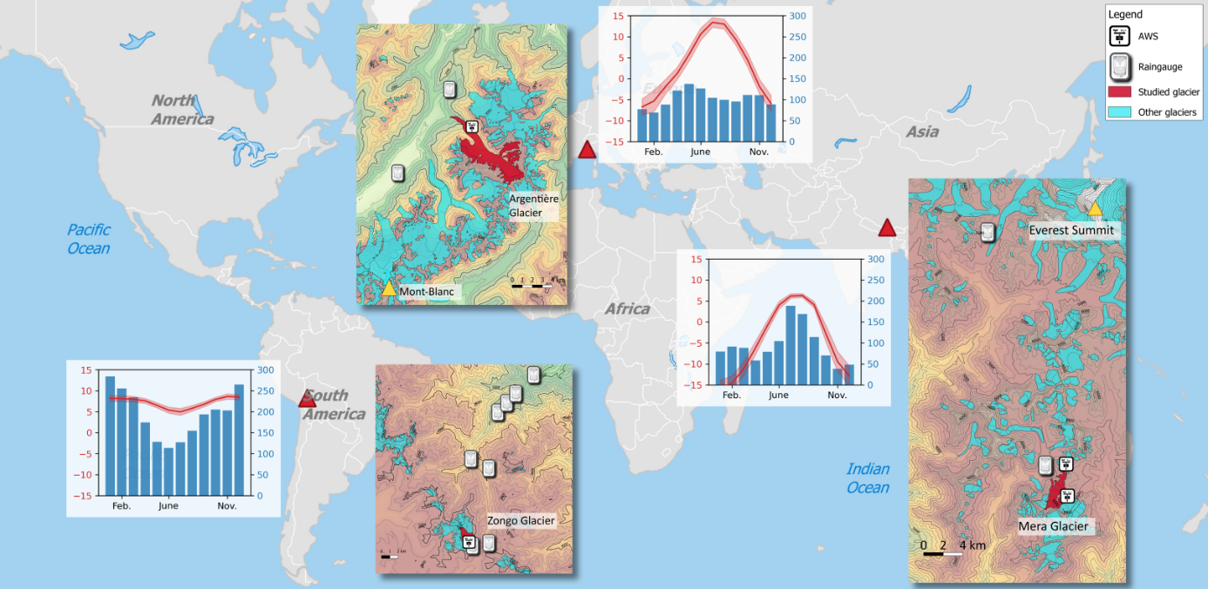

Slide 4
